Slide 1


QUICKSTART SERIES

Slide 2
INSTALLING &
USING KINECT

Slide 3
INTRODUCTION
Designed to get you started
Assume you have some programming experience
Managed API - Concepts work in both VB/C#

Slide 4
QUICKSTART SERIES
Installing and Using the Kinect Sensor
Setting up your Development Environment
Camera Fundamentals
Working with Depth Data
Skeletal Tracking Fundamentals
Audio Fundamentals

Slide 5
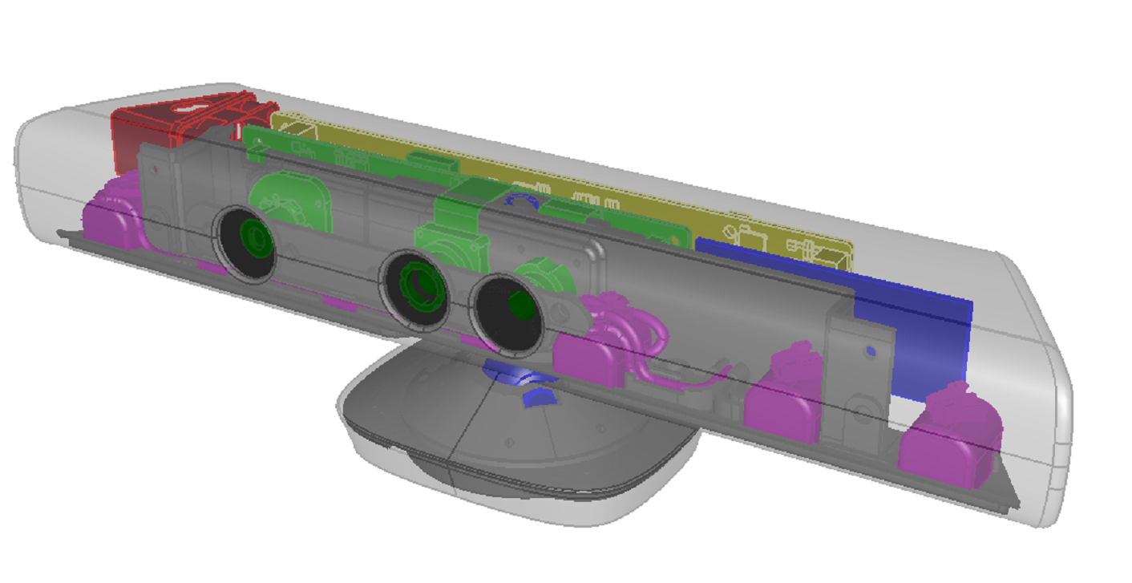
KINECT SENSORS
IR Emitter
Color Sensor
IR Depth Sensor
Tilt Motor
Microphone Array

Slide 6
GET STARTED
http://kinectforwindows.org
Order Kinect Hardware
Download Kinect SDK

Slide 7
INSTALLING AND USING KINECT
DEMO

